Slide 1
Big Mountain Resort Report

Slide 2
Problem Identification
How can Big Mountain Resort increase revenue this season to cover the $1,540,000 operating costs of an additional chair lift?

Slide 3
Recommendation & Key Findings
Based on ski resort data across the country and the features at Big Mountain Resort, the weekend adult pass should be increased from $81.00 to $95.87
This cost increase would more than cover the increased operational cost of the additional chair lift

Slide 4
Modeling Results & Analysis
Random Forest Model
Lowest error after cross-validation

Slide 5
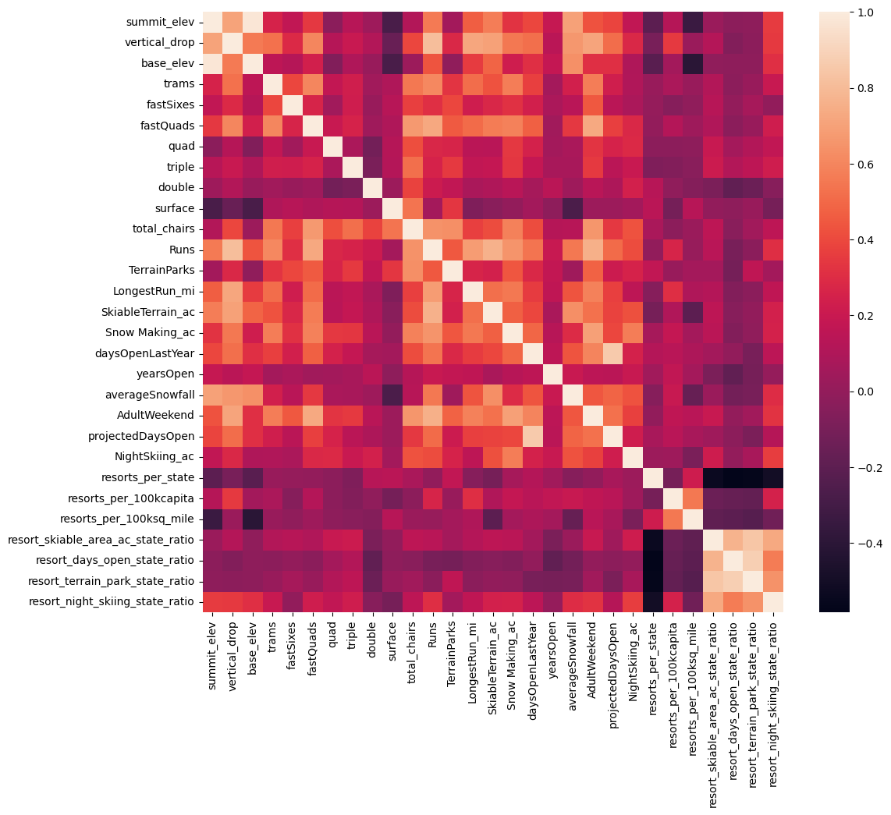
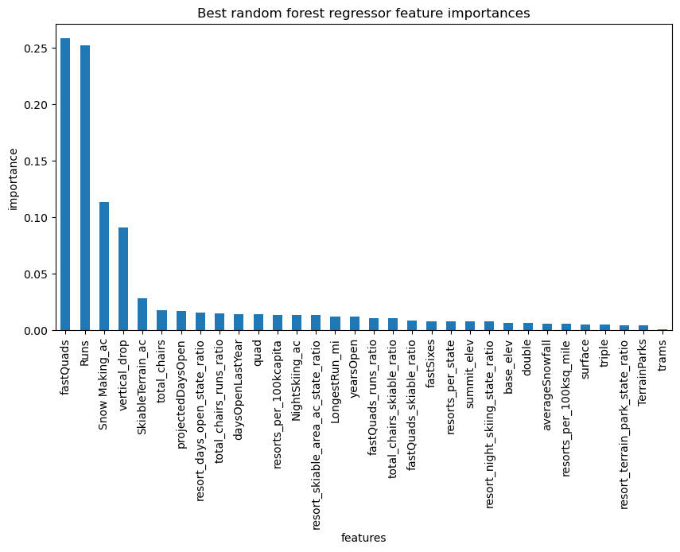
Modeling Results & Analysis
Heat map and bar plot show features that affected price the most
Fast quads, number of runs, snow making, and vertical drop

Slide 6
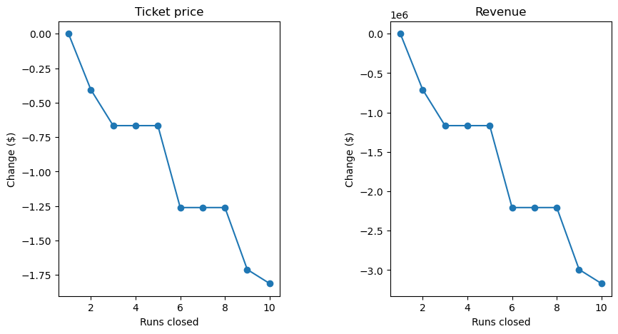
Modeling Results & Analysis
Future changes
Closing 1 run would not affect ticket price or revenue, additional closures drop ticket price and revenue
Adding 1 run and increasing vertical drop by 150 ft would allow Big Mountain resort to increase ticket price by an additional $1.99

Slide 7
Summary & Conclusion
Recommend a price increase for weekend adult pass to $95.87 from $81.00

